Slide 1
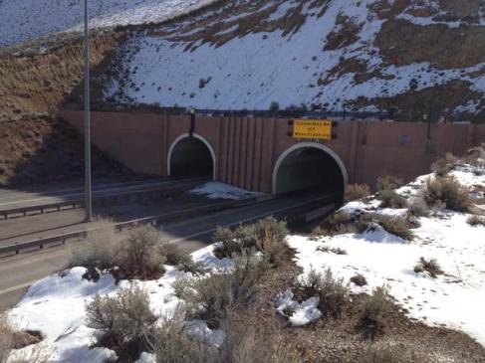
I-80 Carlin Tunnels Project NDOT District III 2012 I-80 Coalition Meeting September 25, 2012

Slide 2
Project Purpose and Objective
Reconstructing the roadway pavement on each side of the tunnels
Rehabilitating and seismically retrofittng the four sets of Carlin Canyon Bridges
Repairing and upgrading the Carlin Tunnels, including improvements to the existing lighting in the Tunnels
Upgrade the ITS elements in the tunnel and the area.
Notes:
2

Slide 3
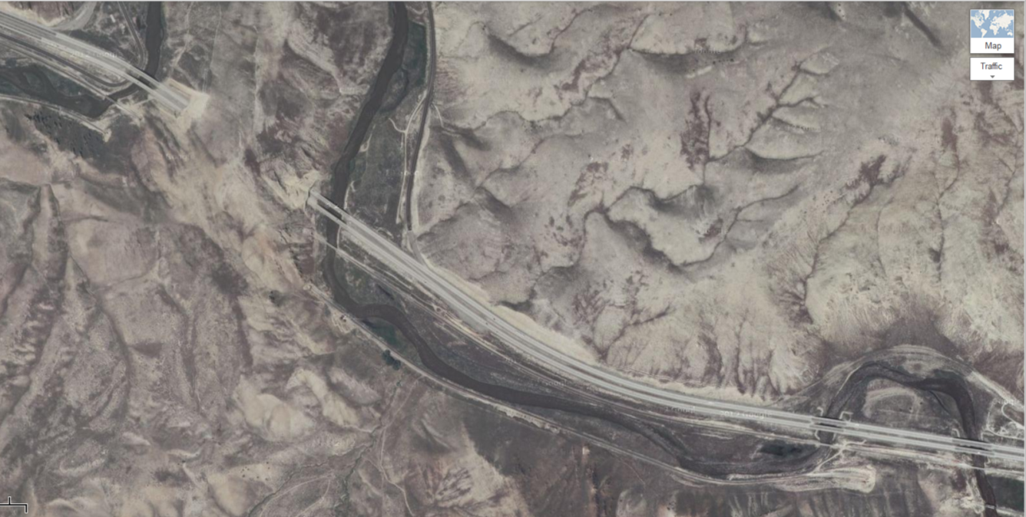
Project Overview
Begin Project
End Project
Notes:
3
The Department proposes to extend the service life of Interstate 80 in Elko County from Milepost EL-7.5 to milepost El-9.33. The Project is located approximately seven (7) miles east of Carlin, NV.
This section of I-80 carries EB and WB traffic through a local canyon and over the Humboldt river.
To address the existing deficiencies, the Project includes, but is not limited to, the following elements:
Reconstructing the roadway pavement;
Rehabilitating and seismically retrofittng the Carlin Canyon Bridges
Repairing and upgrading the Carlin Tunnels, including improvements to the existing lighting in the Tunnels.

Slide 4
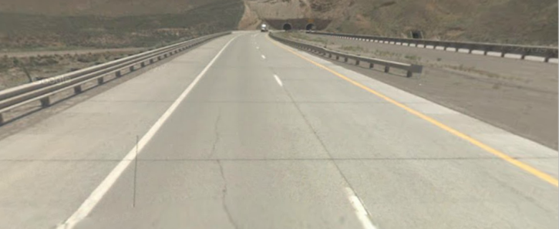
Roadway Pavement Reconstruction
Concrete Pavement was constructed in 1995
Slabs have developed significant and continuous cracking
Repairs, such as crack stitching techniques, have been unsuccessful
Recommendation: Replace concrete pavement with PBS
Notes:
4

Slide 5
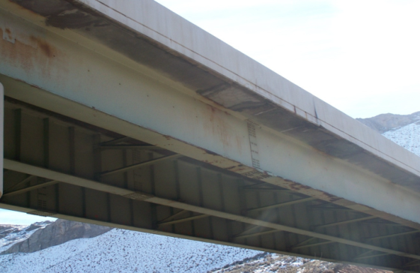
Carlin Canyon Bridges
8 Bridges require Rehabilitation and Seismic Retrofitting
3-span, 3 steel I-girders
Significantly Cracked and Spalled bridge deck overhangs
.
Steel girders and diaphragms exhibit localized paint failures
Paint assumed to contain lead
Notes:
5

Slide 6
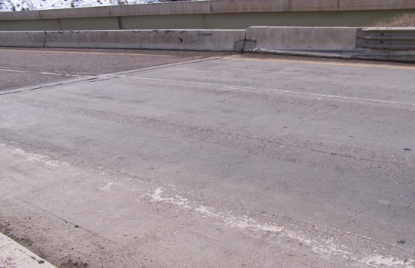
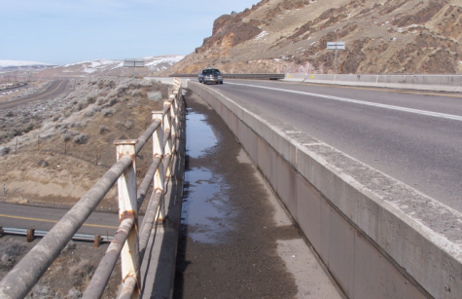
Carlin Canyon Bridges
Rehab Recommendations:
Replace Bridge Deck Wearing Surface
Replace Bridge Rails
Replace Approach Slabs
Replace Expansion and relief joints
Remove Lead-based Paint
Re-paint Superstructure
.
Notes:
6

Slide 7
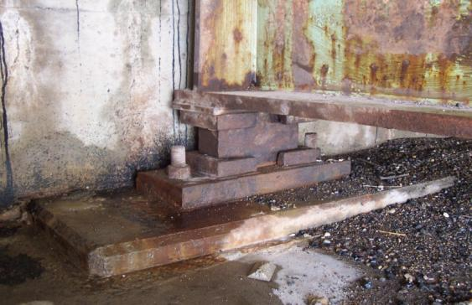
Carlin Canyon Bridges Seismic Retrofit
Structures need to be upgraded to meet FHWA seismic performance level criteria for life Safety
Recommendations: Seismic Isolation Bearing
Replace existing steel bearings with seismic isolation bearings
This option avoids work next to the river and retrofitting existing pier footings
.
Notes:
7

Slide 8
Carlin Tunnels Repair and Upgrade
Original Construction in 1972
Alkali-silica Reactivity (ASR) is present in the tunnels
Extensive deterioration of pavement section and safety walks
Deterioration of portal headwalls
Tunnel Lighting is insufficient
Slope stability concerns
Notes:
8

Slide 9
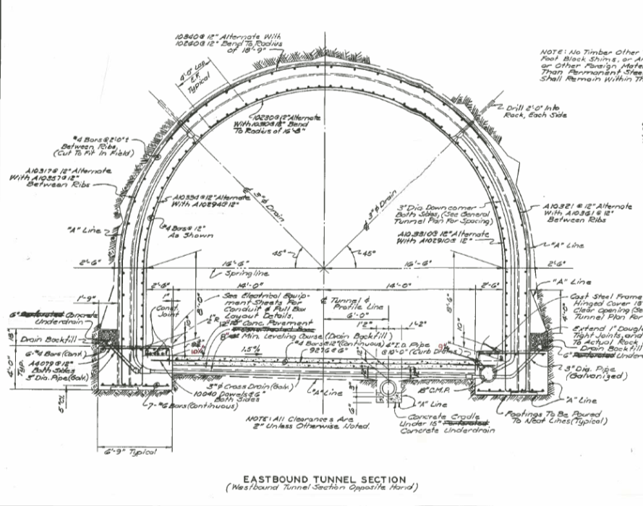
Carlin Tunnels Repair and Upgrade
Recommendations:
Notes:
9
• Replacing all roadway slabs within the Tunnels;
• Removing and replacing at least six (6) inches of concrete around the accessible
perimeter of all safety walks;
• Replacing damaged and missing wall tiles;
• Removing and replacing waterproofing membrane and joint sealer on removable
reinforced concrete access covers behind both portal headwalls.
• Locating and removing problematic light hangers;
• Removing and upgrading existing lighting system;
• Installing intelligent transportation systems (ITS) including photometric controls, central
system integration, and incident detection and communications; and

Slide 10
Project Risks
Environmental impacts to rehabbing and retrofitting bridges over the Humboldt River and within surrounding areas;
Coordination and scheduling of multi-disciplinary work in confined areas;
Design alternatives of tunnel and roadway pavement sections and constructability ;
Constructability of the tunnel pavement section and hydraulic features;
Limited quality material sources;
Traffic control, including duration of tunnel closures
.
Notes:
10

Slide 11
Project Goals
Successfully coordinate, design, and construct a complex, multi-disciplinary Project
Minimize impacts to traffic while considering sequencing, duration, and limits of roadway and tunnel detours, closures, and winter shut-downs.
Reconstruct the roadway, retrofit the Project bridges, and repair the Tunnels with the highest quality Project materials available considering the Project risks.
Complete the project with zero (0) environmental compliance incidents or issues, adhering to all permits, stakeholders, and Departmental environmental commitments and requirements.
.
Notes:
11

Slide 12
Project Goals (continued)
Maximize the service life of Project improvements by applying innovations in construction materials, means, and methods.
Build a professional and collaborative Project Team.
Strive to achieve zero (0) change orders on the Project resulting from the Project Team’s failure to identify and manage Project risks.
.
Notes:
12

Slide 13
CMAR Overview
NDOT’s use of the CMAR delivery method
Nevada Revised Statute (NRS) Requirements
CMAR Prequalification Requirements
NDOT’s CMAR Project Process
Notes:
13

Slide 14
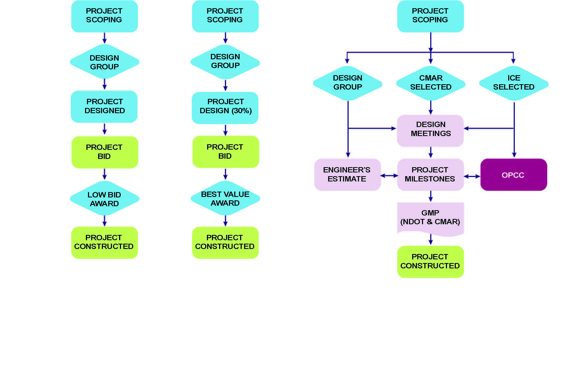
Project Delivery Methods
Design-Bid-Build
Design-Build
Construction Manager at Risk (CMAR)

Slide 15
NDOT’s CMAR Process
We are here!

Slide 16
CMAR Preconstruction Phase
ICE 1
ICE 2
ICE 3
GMP
Partnering
OPCC 3
OPCC 2
OPCC 1

Slide 17
RFP Schedule
Event Time Date
RFP Release N/A August 28, 2012
Mandatory Pre-Proposal Meeting 10:00 a.m. September 6, 2012
Proposer’s Written Questions Due 3:00 p.m. September 17, 2012
Department’s Written Responses Due N/A September 20, 2012
Proposal Due Date 3:00 p.m. September 27, 2012
Notification of Competitive Shortlist N/A October 15, 2012
Debriefing of Non-shortlisted Proposers TBD October 18, 2012
Interviews TBD October 23-24, 2012
Notice of Intent to Award N/A October 25, 2012
Transportation Board Approval N/A December 10, 2012
Notice of Award N/A December 12, 2012
Debriefing of Shortlisted Proposers TBD November 1, 2012
Notes:
17

Slide 18
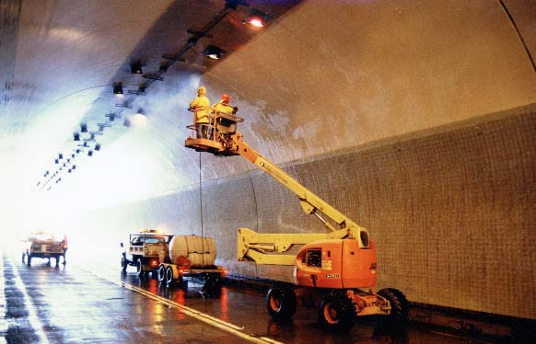
Your Questions Please…
Notes:
18

